Slide 1
Extending the American Revolution Overseas: Little-known Origins of U.S Foreign Assistance and Lessons for Today
Part II: 1950 - 2015
John A. Sanbrailo
Executive Director
Pan American Development Foundation
USAID Alumni Meeting
January 23, 2015

Slide 2
History Matters
Lessons from the Past
Achievements & Shortcomings
Identify Patterns & Trends
Guide Policy & Programming
“History defines us…” (or “…history is bunk…”)
“Means” not an “end”……
Great & Inspiring Story

Slide 3
History Matters
Rajiv Shah
USAID Administrator
“We need to adopt lessons from our own history to bend the curve of progress and foster a spirit of entrepreneurism and innovation”
USAID Frontiers in Development
September 2013

Slide 4
Agenda
Why USAID?
Vision for USAID
John Kennedy in his words
Evolution of USAID (1961 – 2015)
Telling the USAID story
USAID Legacy

Slide 5
Foreign Aid History
Founding Fathers
19th Century Advocates
Progressive Reformers (1900-1930)
New Deal Innovators (1930s-1940s)
……………
“Majestic Moment”(1940s & 1950s)
USAID & others (1961-2015)

Slide 6
“Majestic Moment” WW II & Cold War transition
Foreign Aid: 1940s
Four Freedoms & Atlantic Charter
Export Import Bank
Lend Lease & BEW/ECA
Institute for Inter-American Affairs (IIAA)
Brenton Woods & UN Institutions
Truman Doctrine: Aid to Greece-Turkey (ECA)
Marshall Plan – Europe (ECA)
Dodge Plan – Japan (military/ECA)
Point Four: Underdeveloped countries (TCA)

Slide 7
Franklin Roosevelt Four Freedoms Overseas 1941
Franklin Roosevelt
1882-1945
“Four Freedoms”

Slide 8
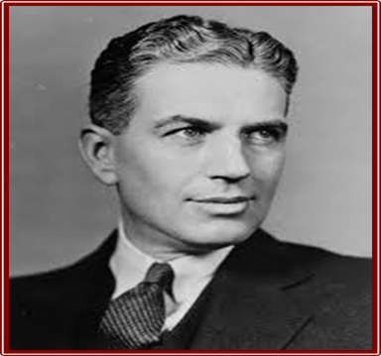
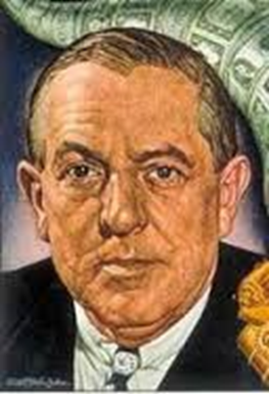
New Deal Innovators
1940s
Henry Wallace
1888-1965
Harry Dexter White
1892-1948
Harry Hopkins
1890-1946
Guy Rexford Tugwell
1891-1979
Nelson Rockefeller
1908-1979
Paul G. Hoffman
1891-1974
Averell Harriman
1891-1986
David Lilienthal
1899-1981

Slide 9
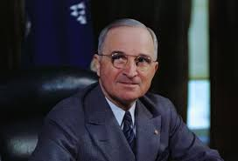
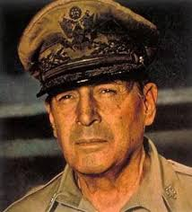
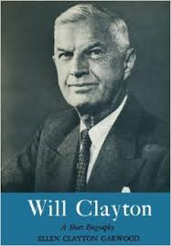
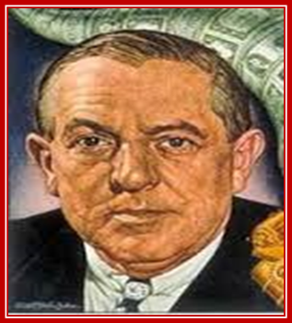
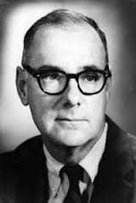
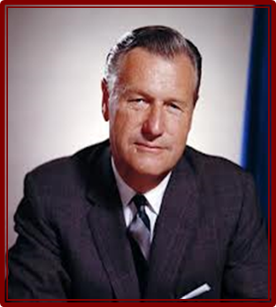
Post-World War II Foreign Aid Advocates 1945-1950
George Marshall
1880-1959
Harry Truman
1884-1972
Douglas MacArthur
1880-1964
Will Clayton
1880-1966
Richard Bissell
1909-1994
Benjamin Hardy
1906-1951
Paul G. Hoffman
1891-1974
Nelson Rockefeller
1908-1979

Slide 10
Foreign Aid: 1950s Containing Communism USAID Predecessor Agencies
Economic Cooperation Administration (ECA)
Technical Cooperation Administration (TCA)
Mutual Security Agency (MSA)
Foreign Operations Administration (FOA)
International Cooperation Administration (ICA)
Export-Import Bank (capital assistance)
PL-480 Program (Food Aid)
Development Loan Fund (DLF)
NGOs & Contractors

Slide 11
Why USAID? 1958-1961
Cold War Tensions & Cuban Revolution
Sense of crisis: “One Minute to Midnight”
Third World as ideological battleground
Criticism of aid fragmentation & “Ugly American”
New Approaches to Development-Modernization
Election of John Kennedy & Inaugural Address
Kennedy’s view of State Department
New aid instruments to fight cold war & support “decade of development” (USAID, Peace Corps, IDB, PADF)

Slide 12
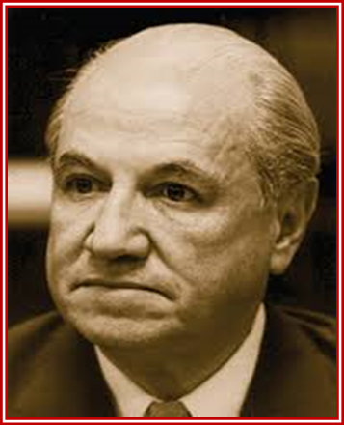
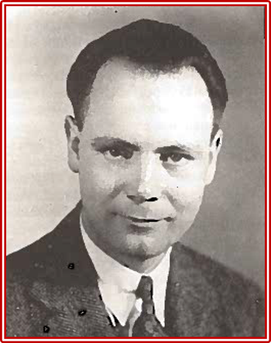
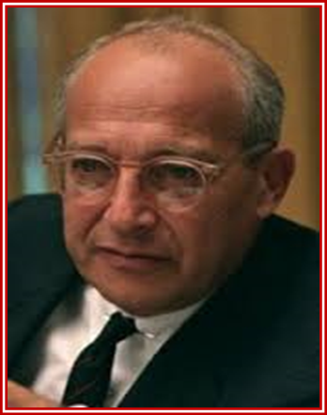
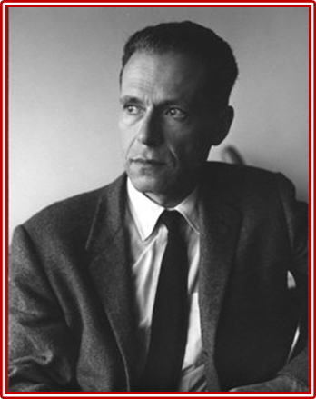
NEW DEVELOPMENT IDEAS 1960s
Raul Prebisch
1901-1986
Eugene A. Staley
1907-1989
Walt Rostow
1916-2003
Albert Hirschman
1915-2012
“Charles River Group of Economists”

Slide 13
Foreign Aid: 1960s
Birth of USAID
Kennedy’s Development Approach
Consolidate Aid (grants-loans) in new Agency (USAID)
Replicate Marshall Plan - Puerto Rico (ECLA model)
Country Programming - National Planning (program loans)
Structural Reforms (land, tax, industry, labor, housing, “basic needs”)
Economic Growth (through policy-structural reforms & private sector develop.)
Meet Basic Needs (land, work, homes, education, health)
Democratic Nation-Building (public administration, grassroots organ.)
Counterinsurgency (public safety, civic action, CORDS)
Field Missions & Country Team Approach
Multilateral Review of Country Plans (OAS & “Wise Men”)

Slide 14
Alliance for Progress Beginnings of USAID 1961 - 1963
https://www.youtube.com/watch?v=7Co6rjlprsg

Slide 15
Foreign Aid:1961-2015 USAID History
1960s: Alliance for Progress & Decade of Development
1970s: New Directions & Basic Human Needs
1980s: Market-Trade Reforms & Democracy Promotion
1990s: Fall of Communism & Sustainable Development
2000s: War on Terror/Drugs, MDGs, HIV/AIDS, PMI
2011-2015: USAID Policy Framework & “New” Initiatives

Slide 16
TELLING USAID STORY Different Approaches
Top-Down: (Policies, Reforms, Budgets, FAA, Administrators)
Bottom-Up: Missions (“focus on shop-floor”)
Development Ideas & Strategies
Sectors & Projects (“50 years of USAID”)
Regions & Countries (“Follow the money”)
Others (USAID milestones & leaders)

Slide 17
USAID Legacy 1961-2015
Transferred $500 billion+ (development inputs)
Outputs
Alleviated Poverty (for hundreds of millions)
Promoted economic growth
Pioneered new development-democracy approaches (policies, programs, methodologies, strategies)
Established-Strengthened Institutions (public-private sectors)
Generated-Disseminated new technologies (green revolution, ORS therapies, non-formal education, micro-finance, policy dialoguing-institution building processes)

Slide 18
USAID Legacy
1961-2015
Outputs (cont.)
Aided victims of natural disasters & humanitarian crises
Managed transnational challenges(famines, HIV-AIDS)
Disseminated aid best practices to donors
Nation-building successes (Taiwan, S.Korea, DR, El Sal, Colombia) & shortcomings (Vietnam, Haiti, Liberia, Iraq, Afghanistan)
Extended American development-democracy values overseas (in support of foreign policy)

Slide 19
Conclusions
Foreign Aid deeply rooted in American history
Inspired by principles of American Revolution
Mixture of idealistic/realistic impulses in foreign policy
Lessons from 200+ years of spreading democracy & development around the world
USAID 50+Years largest and most important
To know what we have done is to know who we are

Slide 20
Recommendations
Recognize History Matters
Build a “learning organization” on lessons from past
Establish USAID Office of the Historian
Place foreign aid policies/programs/reforms in
historic context
Develop lessons learned in systematic manner
Draw on past to guide programming/training

Slide 21
Annex One
Telling USAID Story
1961 – 2015
USAID Field Missions (bottom–up approach)
Development Ideas & Strategies
Sectors & Projects (“50 years of USAID”)
Regions & Countries (“Follow the money”)
Milestones in USAID History
Others

Slide 22
USAID Field Missions “Bottom-up approach” Country Studies 1960s-2010s
Successes: Taiwan, South Korea, Chile, DR, Costa Rica, El Salvador, Colombia, EE countries, etc.
“Less Successful”: Vietnam, Liberia, Haiti, Nicaragua, selected African-Middle Eastern countries
Country Studies: Prepared by USAID Missions & others
Others: (e.g. “Secret Successes of USAID” by Michael Pillsbury; “Real Progress: Fifty Years of USAID in Costa Rica” by Jim Fox; History of USAID Bolivia-Larry Heilman; History of USAID Ecuador-John Sanbrailo, Sam Butterfield book, EE Study, “50 Years of USAID: Stories from the Front Lines”, etc.)

Slide 23
Development Ideas 1960s – 2010s
1960s: “The Stages of Economic Growth: A non-communist manifesto” Walt
Rostow, “Political Order in Changing Societies” & “Foreign Aid: For What
and For Whom” Samuel Huntington
1970s: “Development Reconsidered: Bridging the gap between government and
people” Edgar “Ted” Owens & Robert Shaw; “Small is Beautiful: Economics
as if People Mattered” E.F. Schumacher
1980s: “Free To Choose” & “Capitalism and Freedom” Milton Friedman &
privatization literature
1990s: “The End of History and the Last Man”, Francis Fukuyama & Sustainable
Development literature (the Club of Rome, Barbara Ward)
2000s: “The Clash of Civilizations and the Remaking of World Order” Samuel
Huntington & “End of Poverty: Economic Possibilities for Our Time” Jeffrey
Sachs, Economic Growth literature (William Easterly, Benjamin Friedman)
2010s: Governance literature (“Political Order and Political Decay: From the
Industrial Revolution to the Globalization of Democracy” Francis Fukuyama

Slide 24
Development Strategies 1960s – 2010s
1960s: Comprehensive National Development &
Counterinsurgency (DR-Vietnam-others)
1970s: New Directions: Focus on Rural Poor & Family
panning
1980s: Shift to Market-driven Development (exports-
investment-democracy promotion)
1990s: Support EE Transitions to Market
Economies/Democracy & “Sustainable Development”
2000s: Support War on Terrorism/Drugs. MDGs. HIV/AIDS,
Nation-Building, Democracy, etc.
2010s: End extreme poverty, promote resilient democracies,
advance human dignity

Slide 25
Sectors & Projects 1960s – 2010s
1960s: Policy reform for growth, industrial develop/PS,
land reform, housing, basic needs, etc.
1970s: Rural poverty alleviation: agriculture,
health, education, family planning, etc.
1980s: Policy reform for growth, trade-investment-free
markets, promotion, strengthen democracy, etc.
1990s: Transition free markets-democracy & sustainable
development
2000s: Nation-building, combat drug trafficking, MDGs,
HIV/AIDS, growth-democracy promotion, etc.
2010s: Ending extreme poverty & promoting resilient
democracies, etc.

Slide 26
Regions & Countries “Follow the money” 1960s – 2010s
1960s: Latin America & Vietnam
1970s: Vietnam & Shift to Africa – Israel-Egypt
1980s: Israel-Egypt, Caribbean, Central America, Africa
1990s: Eastern Europe, Russia, Israel-Middle East, Haiti
2000s: Iraq, Afghanistan, Pakistan, Middle-East, Eastern
Europe, Colombia, Africa, Mexico
2010s: Israel, Afghanistan, Pakistan, Iraq, Egypt,
Jordan, African counties, Mexico

Slide 27
Milestones
USAID History
1959-2000
1959: Triumph of Cuban Insurgency
1960: Election of President John Kennedy
1961: Establishment of USAID, Peace Corps, IDB
1965: Escalation of Vietnam War
1971: Establishment of OPIC
1973: New Directions legislation
1979: Camp David & Middle-East Peace Accords
1980: Election of President Ronald Reagan
1989: Fall of Berlin Wall & Collapse of Communism
1990s: Downsizing of USAID & Erosion of USAID
development leadership

Slide 28
Milestones (CONT.)
USAID History
2001-2011
2000: Election of President George W. Bush
2001: Sept. 11 & War or Terror
2003: Invasion of Iraq & Afghanistan
2000s: Large aid increase & “proliferation”
2003-2005: Establishment PEPFAR, MCC, PMI
2006: Creation of State “F” Bureau
2010: QDDR & Integration into State
2011: 50th Anniversary of USAID
2011-2015: New Initiatives & “Whole of Government”
2014-2015: Reform Agenda

Slide 29
Annex Two Foreign Aid History 1789-1950
Founding Fathers
19th Century Advocates
Progressive Reformers (1900-1930)
New Deal Innovators (1930s-1940s)
……………
“Majestic Moment”(1940s & 1950s)
USAID & others (1961-2015)

Slide 30
Foreign Aid Origins
“Foreign aid as we know it began as an instrument of Cold War diplomacy. Without the Cold War, aid would likely not exist today…..”
Carol Lancaster
“Foreign Aid: Diplomacy, Development Domestic Politics ” (2007)
Foreign aid is an expression of the American revolutionary tradition and America’s revolutionary mission in the world.
Gordon Wood,
“Why America Wants to Spread
Democracy Around the World” (2011)

Slide 31
“Majestic Moment” Foreign Aid “Begins” 1940s
Bretton Woods System (IMF, IBRD, GATT)
Other Multilaterals (UN,WHO, FAO)
Truman Doctrine: Aid to Greece & Turkey (ECA)
Marshall Plan/Europe (ECA)
Dodge Plan/Japan (military/ECA)
Point Four: Underdeveloped Countries (TCA)
Export-Import Bank: Financing Development

Slide 32
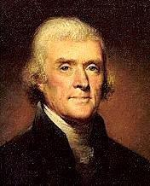
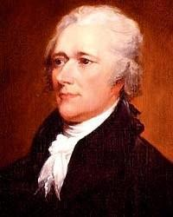
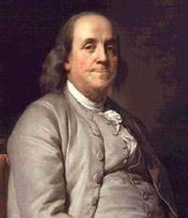
Development Philosophers “Founding Fathers”
Thomas Jefferson Alexander Hamilton Benjamin Franklin

Slide 33
Founding Fathers American Development Ideas
“Observations Concerning the Increase of Mankind & Peopling of Countries”(1751) & others Benjamin Franklin
Declaration of Independence (1776)
“Notes on the State of Virginia” (1785) Thomas Jefferson
“Federalist Papers” (1788) & Constitution (1789)
“Report on Manufactures” (1791), Alexander Hamilton

Slide 34
Echoing Jefferson “…this ball of liberty will bounce around the world…” (1789) Foreign Aid: 21st Century
“….our individual freedom is inextricably bound to the freedom of every soul on Earth….
“We will support democracy from Asia to Africa; from the Americas to the Middle East, because our interests and our conscience compel us to act on behalf of those who long for freedom.”
Barack Obama
January 2013
“…..the survival of liberty in our land increasingly depends on the success of liberty in other lands…”
George W. Bush
January 2005

Slide 35
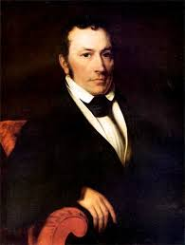
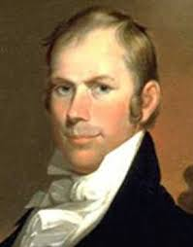
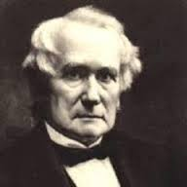
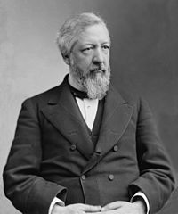
Foreign Aid Pioneers
1800-1930
Joel R. Poinsett
1779-1851
Henry Clay
1777-1852
Henry Carey
1793-1879
James Blaine
1830-1893
Walter Reed
1851-1902
Leonard Wood
1860-1927
Herbert Hoover
1874-1964
Edwin Kemmerer
1875-1945

Slide 36
Foreign Aid
1790s-1890s
1789: Jefferson & Lafayette in France (promoting democracy)
1794: Haitian Refugees & Haiti’s Constitution (1800)
1810s: Chilean independence & Venezuelan earthquake victims (1812)
1819: Establishment of Liberia
1820s: Greek independence (“Greek Fever”) & Mexican democracy
1848: Response to Irish Famine
1862: Aid to English textile workers (“Cotton Famine”)
1870s: Japanese nation-building, Franco-Prussian War, Cen.Am.,
Centennial Exposition (1876) & Grant’s visit to Japan (1879)
1890s: Inter-American Cooperation & Chicago’s World Fair (1893)
1880-90s: Ireland, Russia, India, Armenia, Cuba

Slide 37
Foreign Aid Rejected “A Connecticut Yankee in King Arthur’s Court” 1889
Mark Twain
1835-1910

Slide 38
Foreign Aid Initiatives
20th & 21st centuries
1900s-1920s: Yellow Fever, Nation-Building & “Making World Safe
for Democracy”
1910s-1920s: Food Aid WW I & Assistance to Russia-Eastern Europe
1910s-1920s: Democracy, Famine Relief, Financial Reforms
1930s-1940s: Aid to Latin America and the Caribbean
…………………………………………….
1940s-1950s: Ex-IM Bank, Lend-Lease, IIAA, ECA, Marshall Plan,
Dodge Plan, Point Four, TCA, ICA, DLF, PL-480
1960s-1990s: USAID support of Cold War
2000s-2010s: War on Terror/Drugs/MDGs: USAID, PEPFAR,
MCC, PMI, DOS & “F” Bureau, DOD, DOT, others

Slide 39
Foreign Aid From WW II to Cold War 1940s
WW II Post-War
Atlantic Charter (1941) Bretton Woods (1944)
US Exim Bank IMF/ IBRD
Inter-American System UN/WHO/FAO
Lend-Lease/BEW Marshall Plan/ECA (ARA)
IIAA (1942-49) Point Four/TCA (1950s)
US Exim Bank Exim-DLF (1950s)

