Slide 1
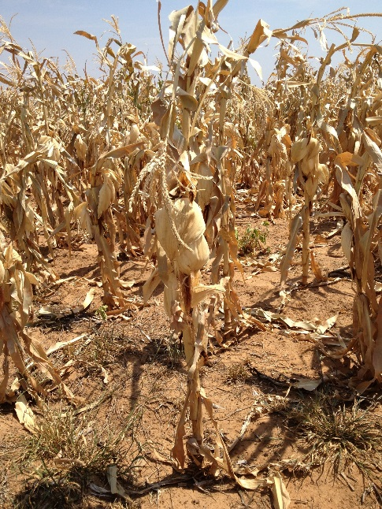
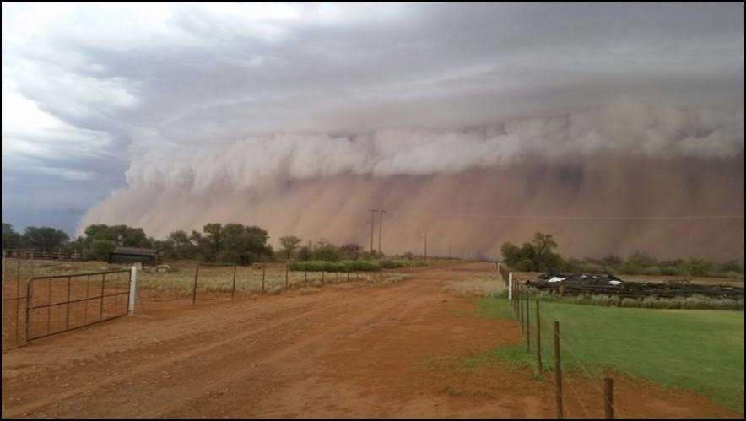
TOOLS FOR EARLY WARNING AND THEIR ROLE IN CONFLICT MITIGATION
“While we can’t prevent drought we can prevent famine”
“Not Again”
Fall, 2016*
8/11/16

Slide 2
TOOLS FOR EARLY WARNING AND THEIR ROLE IN CONFLICT MITIGATION--Overview
Goal: Better understanding of wide range of early warning tools policy makers and program managers alike should use to create momentum for early action/response in order to mitigate potential crises, both natural and man-made
Notes:
Goal: Better understanding of wide range of early warning tools policy makers and program managers alike should use to create momentum for early action/response in order to mitigate potential crises, both natural and man-made
Greater understanding of vulnerabilities
Political, institutional, organizational barriers impede early action
With climate change--increasing number of weather-related severe events with likely longer duration and greater intensity-shocks and stressors are not anomalies
Natural disaster may not lead to conflict, but

Slide 3
TOOLS FOR EARLY WARNING AND THEIR ROLE IN CONFLICT MITIGATION--Overview
Notes:
Water and arable land scarcity = increased political conflict over access to land, water and other natural resources
Example: Analysts point to inadequate government handling of an unprecedented drought in Syria as a trigger for the country’s devastating civil war. (WP 8/10/16)
Link between early warning to early action clear
Use EWT for faster, more decisive action based on evidence – less loss of life, less destruction, less likelihood of political instability and less costly
It is a long-established factoid that investing $1 in preparing for crises will save you $7 responding to them, and yet it has proven very difficult to make that shift. At the recent GHS, UN’s disaster risk reduction body called for a “marker” to track DRR spending--no specific target was set

Slide 4
TOOLS FOR EARLY WARNING AND THEIR ROLE IN CONFLICT MITIGATION--Overview
Famine early warning-most successful example of EW tool with global acceptability
Risk appetite weak = slower response

Slide 5
TOOLS FOR EARLY WARNING AND THEIR ROLE IN CONFLICT MITIGATION--Overview
Many tools now available for policy makers and program managers
30 years of systems evolution (data collection, analysis and dissemination)
Timely, credible information and analysis possible
Draw from evidence-based analysis to “map” or forecast problem
Natural disasters-good track record of identifying likely hot spots and vulnerabilities and in some cases alerting to probable disaster (droughts in Somalia 2010, Sahel 2012)
Examples: Tornado, Volcano and Hurricane EW, Tsunami EW, Famine Early Warning (IPC, FEWS), VAM, GIEWS; Livelihood analysis
Increased focused on regional nature of problem(s) and required regional collaboration in response

Slide 6
TOOLS FOR EARLY WARNING AND THEIR ROLE IN CONFLICT MITIGATION--Overview
Humanitarian system has grown massively in recent years
Proportionate improvement in performance during emergencies lacking however
The humanitarian sector’s best organisational set-up, financing and approaches – largely built in the aftermath of the 2004 Indian Ocean tsunami – are tailored for responding to natural disasters where EW is strongest and easily understood and accepted
Today, however, close to 80 percent of humanitarian response takes place against a backdrop of protracted conflict. And there, the system struggles
For some such as the ICRC, the Syrian war and resulting refugee crisis has forced the realisation that protracted conflict must be at the core of humanitarian work
GHS committed to significantly increase prevention mitigation and preparedness measures for early action to anticipate and secure resources for recovery. The finance ministers of the Vulnerable 20 Group launched, alongside the World Bank and the UN, a new partnership to help their countries better prepare for shocks, including better access to risk analysis, contingency plans and social protection schemes
Not translated into policies and actions yet

Slide 7
TOOLS FOR EARLY WARNING AND THEIR ROLE IN CONFLICT MITIGATION--Overview
“Predicting/forecasting” political crisis/conflict hard-we didn’t see Turkey coup, let alone Ukraine invasion nor collapse of USSR
Data driven risk lists can be good identifier of likely crisis
Political risk lists-not welcomed by country identified!
Governments reluctant to declare famine
Examples: Analytical Commentary (ICG CrisisWatch), Risk Lists (USAID, Fund for Peace/Foreign Policy magazine, Global Conflict Risk Index, UMd Peace and Conflict Instability Ledger, Eurasia Group's annual forecast of the political risks, IMF, CIA)

Slide 8
TOOLS FOR EARLY WARNING AND THEIR ROLE IN CONFLICT MITIGATION--Overview
Tools differentiate possible conflict drivers (e.g, drought vs. contentious elections)
Gap remains between early warning and early action leading to mitigation and prevention
Good track record “predicting” hasn’t translated into good track record of triggering early action; longer lead times = delay and prevarication
Too much supply driven programming
Risk reduction efforts better (new focus on resilience to build adaptive capacity to recover from shocks); greater appreciation for multi-sectoral and multi-funding streams; strong vulnerability mapping by UN and NGOs alike; better contingency planning that enhances preparedness
Scenario development not a science
Small fire doesn’t always lead to BIG ONE hence caution

Slide 9
TOOLS FOR EARLY WARNING AND THEIR ROLE IN CONFLICT MITIGATION--Overview
Caution can breed lower risk appetite
Policy makers remain reluctant to react EARLY and quickly (ex.,2010-11 Somalia drought), reluctance to hit “go” button too quickly
Not front burner, funding constraints, aid diversion, institutional competition or disagreement, no guarantee that action makes problem disappear, political risk trumps humanitarian risk
CFS Framework for Action for Addressing Food Security and Nutrition in Protracted Crisis urges early action
Accountability for action No accountability = low priority
No incentive for early action, but plenty of downsides

Slide 10
TOOLS FOR EARLY WARNING AND THEIR ROLE IN CONFLICT MITIGATION-FEWS
Famine Early Warning System (FEWS)—What is it?
Analysis accepted internationally
monitors dozens of different indicators
Operates in 25 countries
“convergence of evidence”
Key Analytical Tools used for “prediction”
-Household Economy Assessment (HEA)
-Integrated Phase Classification for Food Security (IPC)
Build baseline understanding of household level economy to forecast future shocks

Slide 11
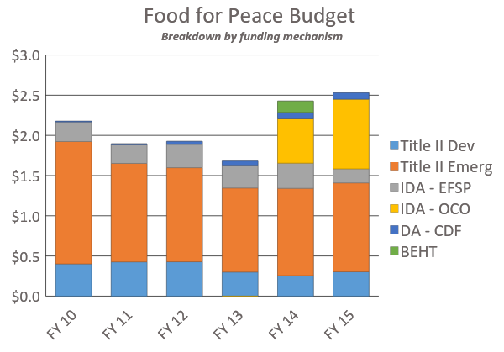
WHY DOES USAID INVEST IN FAMINE EARLY WARNING?
Evidence
basis for decision-making
unbiased
Prioritization
demand for assistance is greater than available resources

Slide 12
FEWS NET 30 YEARS TRYING TO PREVENT FAMINE
Notes:
For 30 years, USAID has been trying to compare countries and figure out where needs were most severe. After a series of food crises and severe famines in Ethiopia and the Sahel, there was a clear recognition that of one simple premise: famine doesn’t happen overnight. People don’t just start dying from food insecurity – it takes weeks even with zero food and months with constrained access to food. Doesn’t that give us some way to know about it in advance and hopefully, prevent it or at least mitigate it?
Nearly three decades on, thousands of people have been worked on this question as part of the FEWS network. The science and technology has improved hugely over the last 30 years. When I started on this project in 1992, we had top technology – modems we left on overnight, with the hope it would successfully download a simple satellite image over the phone lines. Color printers were also a hallmark (unlike this map) of our advanced technology.
Vast amounts of progress made. I will share some of the advances in the science, then describe why it is still mostly an art, and how famine can still happen. After the break, I will give you an exercise to see for yourself what we know – and what we might still miss.

Slide 13
HOW DOES FEWS NET WORK?
SCIENCE
Long-standing inter-agency agreements with USGS, NOAA and NASA provide satellite imagery and agro-climatic analysis
SOCIO-ECONOMIC DATA
Field staff in more than 20 countries and in the US collect data on many aspects of food security
ART
The human factor remains critical. Analysts in the field and in the US weigh different data and information available to make final determination
FROM DATA TO DECISIONS, Partnership for Public Service, November 2013

Slide 14
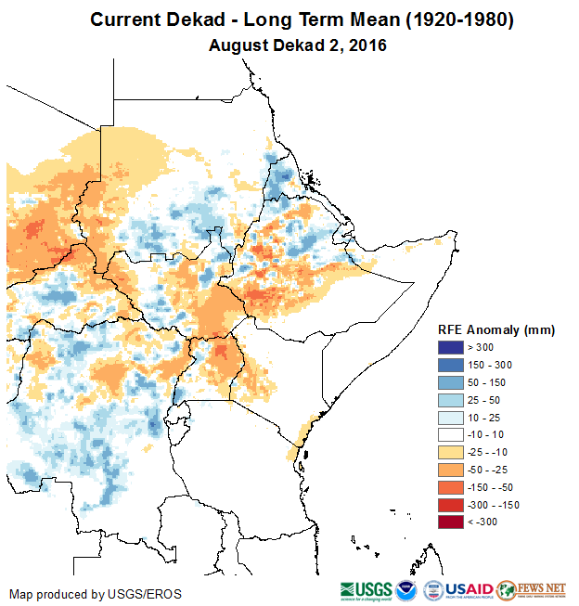
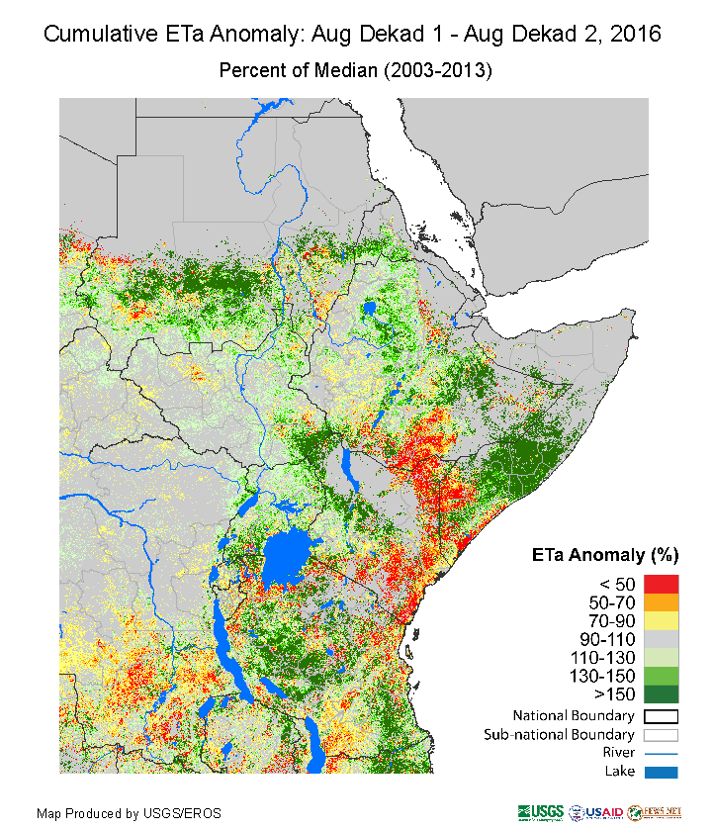
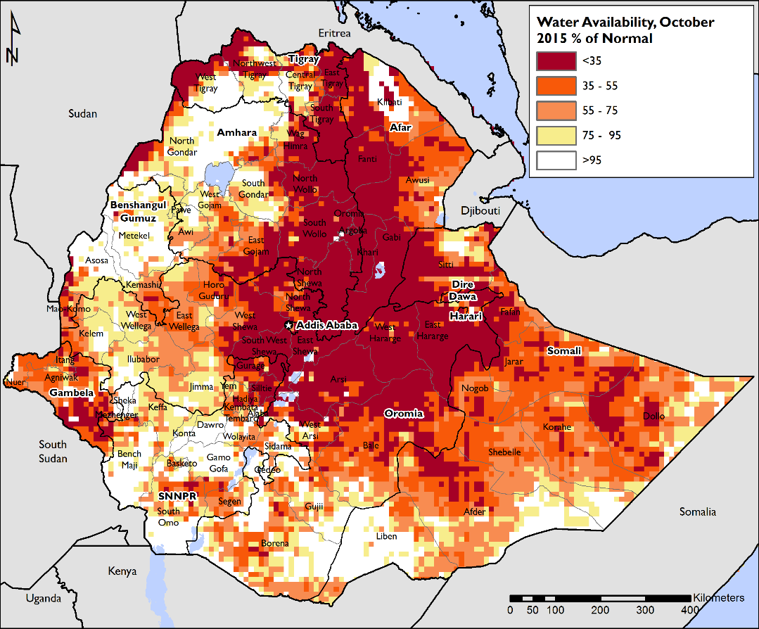
The Science Decades of satellite images - continuous innovations
Notes:
Many people associate FEWS NET with early use of remote sensing, including the first operational use of NDVI. However the science partners have continued to push out a range of new an innovative tools in recent years including: CHIRPS, eTA, surface water availability estimation, and waterhole monitoring. Many of these new products can be found in the maps books for South and Ethiopia that we published over the last year
· USGS has been assisting us for the past 3 years to estimate area planted at sentinel sites using high res imagery in South Sudan and Yemen (example attached)
· We are currently working with USGS and UMD on a national scale planted area estimation activity in South Sudan based on Landsat.

Slide 15
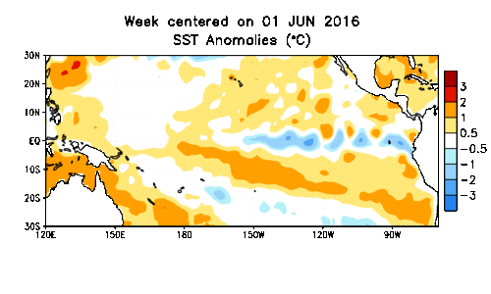
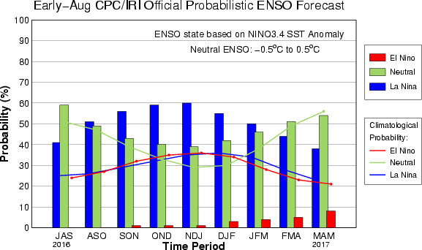
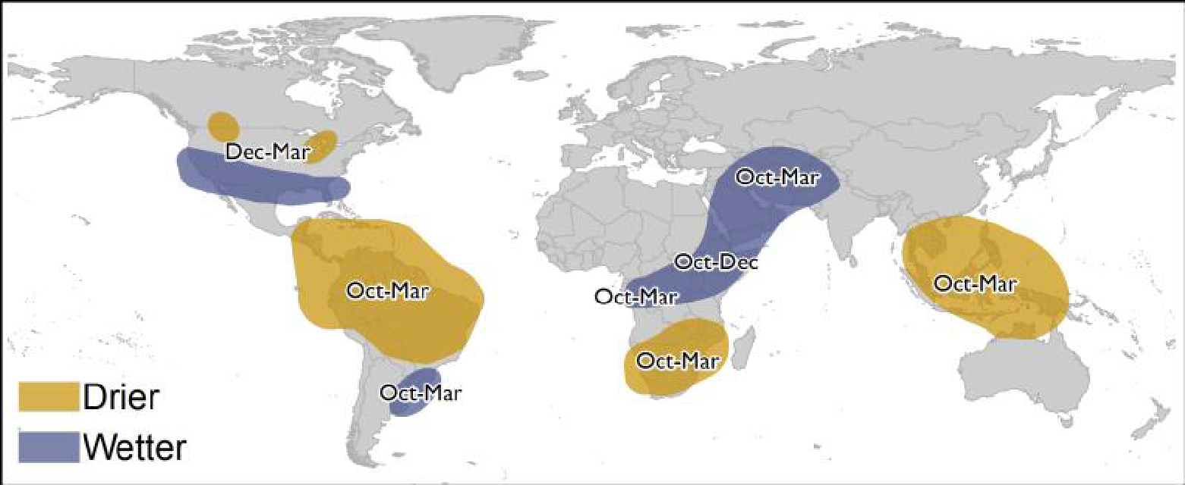
The Science Great advances in understand global climate, especially El Nino/La Nina
El Niño impacts on rainfall
October 2015 – March 2016 (Forecast)

Slide 16
The Socio-Economic Data
FEWS NET Data Streams
Agriculture
Markets and Trade
Crop calendars
Area planted
Input availability
Rainfall
Yields
Pasture conditions, etc.
Market prices
Market functioning
Trade flows
Wage rates
Inflation rates
Informal trade, etc.
Livelihoods
Nutrition and Health
Anthropometric data
Weight/height
Weight/age
Growth faltering
Mortality
Morbidity
Health clinic attendance, etc.
Notes:
(See Animation) Over the years FEWS NET has built up a body of contextual/historical information across the key sectors of agroclimatology, markets and trade, livelihoods, and nutrition.
For ex: historical price data across countries; agroclimatology data, livelihoods maps and profiles, nutrition surveys.

Slide 17
Understanding local livelihoods
Open website: www.fews.net
Go to Countries & Regions
Under East Africa, click on South Sudan
Scroll to bottom of the South Sudan country page, to the section on Livelihoods
Open the South Sudan Livelihoods Descriptions file
http://www.fews.net/east-africa/south-sudan/livelihood-description/august-2013

Slide 18
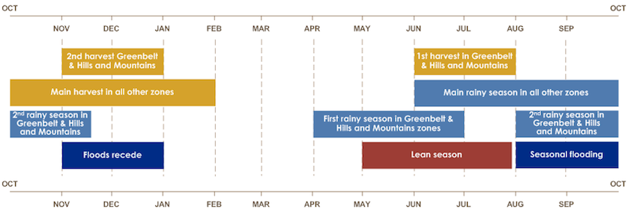
Focus on Livelihood Zone 8 Understanding seasonal calendars
South Sudan general
Specific calendars per LHZ
Notes:
As part of its scenario development methodology, FEWS NET analysts look at livelihoods in a given country or zone to understand how people normally live (the baseline) and what options, or coping strategies, they have in the event of a shock.
Take a few minutes to read the description of LHZ8.

Slide 19
Conflict erupts: Focus on Livelihood Zone 8
Notes:
Conflict erupted in Dec 2013. Look at conflict heat maps showing the intensity and number of conflicts.
The Armed Conflict Location & Event Data Project (ACLED) is a publicly available conflict event dataset designed for disaggregated conflict analysis and crisis mapping. This dataset contains information on the dates and locations of all reported political violence events in over 50 developing countries, with a focus on Africa. The data are drawn from news reports, publications by civil society and human rights organisations, and security updates from international organisations.
The maps are produced by plotting the latitude & longitude coordinates for ACLED events. We then use Kernel Density, which is a point density analysis tool. The tool creates a grid of equally sized square pixels. It then counts the total number of points located within a radius of each pixel, in this case we used a 50km search radius. During counting, the points closer to a pixel are given a higher weight, and have a greater impact on the count. Points on the edges of the search radius will have a lower impact on the count. The count for each pixel is divided by the search area, resulting in a count-per-unit area. The resulting values are then visualized using a color scale. The maps are not population density based.
The Armed Conflict Location & Event Data Project (ACLED) is a publicly available conflict event dataset designed for disaggregated conflict analysis and crisis mapping. This dataset contains information on the dates and locations of all reported political violence events in over 50 developing countries, with a focus on Africa. The data are drawn from news reports, publications by civil society and human rights organisations, and security updates from international organisations.
Identify drivers of conflict for effective peace-building and conflict mitigation. For example, by determining whether violence is centred around resource deposits, border lands, contested areas, zones of higher or lower poverty, or areas of particular livelihood strategies or vulnerabilities
As of early 2016, ACLED has recorded over 100,000 individual events, with ongoing data collection focused on Africa and ten countries in South and Southeast Asia. The data can be used for medium- and long-term analysis and mapping of political violence across developing countries through use of historical data from 1997, as well as informing humanitarian and development work in crisis and conflict-affected contexts through realtime data updates and reports. ACLED data show that political violence rates have remained relatively stable in the past seventeen years, despite the waning of civil wars across the developing world. ACLED seeks to support research and work devoted to understanding, predicting and reducing levels of political violence.

Slide 20
Brainstorm: What baseline livelihood factors might be affected by conflict?
Effects on food production (fear of farming, lack of tending fields, no access to fishing)
Effects on markets and trade (unable to buy food, unable to sell anything produced eg handicrafts, high prices)
Lack of humanitarian access (no food aid or other assistance)
Loss of livestock (looting, killing)
Human displacement
Notes:
Ask students to list some livelihood factors that might be impacted in LHZ 8. (On a white board if available) Then show my list to see if they match.

Slide 21
Effects on food production
Estimating changes in planted area with high resolution satellites
100 meter grids created and interpreted by hand
Notes:
Can we use advanced tools to track effects of conflict on food production?
Imagery from July 2014 was divided into a 100 meter dot grid and interpreted by staff at the USGS Earth Resources Observation and Science (EROS) Center in Sioux Falls, SD. Each grid dot was classified as not cultivated, cultivated this year, cultivated this year but no crops growing, fallow, or settlement (Figure 2). A similar analysis was conducted using imagery from June 2012 (a relatively normal year for cropping) (Figure 1). The two sets of results were then compared to assess whether any changes to cropped area had occurred. A comparison of the 2012 and 2014 indicates that planted area has declined by roughly 30 percent (Table 1). In addition, during image interpretation, fields were classified as cultivated if any crops were present, even if only a small portion of the grid square was planted or crop conditions were poor. Therefore, the 30% decline in planted areas is likely to be a conservative estimate. These results are generally consistent with July field interviews

Slide 22
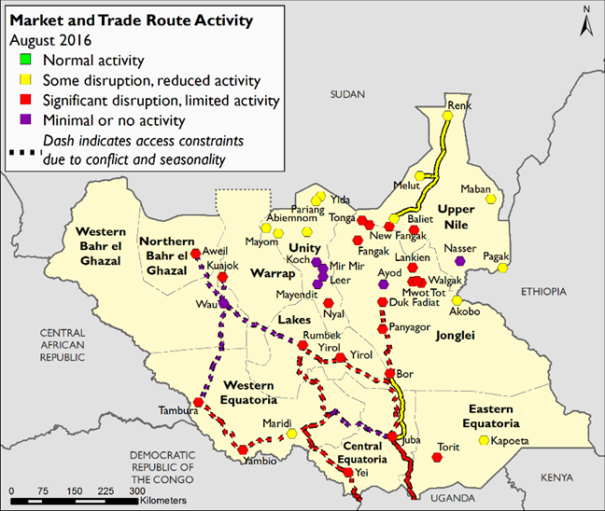
Effects on markets
Notes:
Attempts to track market disruptions – key to understanding abilty to access food through markets.

Slide 23
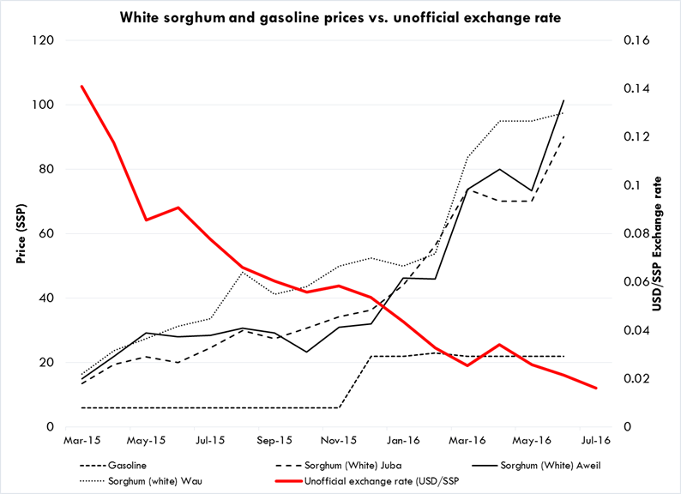
Effects on prices
Notes:
Prices are a great indicator – not just basic food prices, but things like prices of gasoline and the exchange rate.

Slide 24
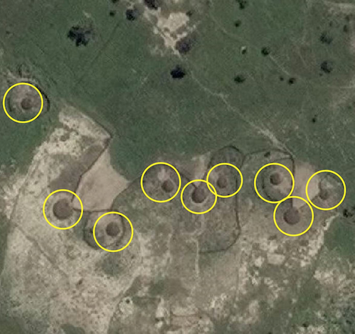
Displacement due to conflict - using high tech to find the people
Permanent dwellings include tukuls (circular-shaped local homes) and concrete block buildings. Tukuls have cone-shaped tops and a shadow will be visible due to its height. Many tukuls have been burned down in this area due to conflict. Do NOT tag burned-down dwellings. Burned dwellings will lack a shadow (height) and the usual cone shape.
Notes:
New crowdsourcing technology – same one used to try to find the Malaysian Airliner in the ocean.
FEWS NET partnered with Tomnod to use the power of crowdsourcing in evidence-based food security analysis.
On Tomnod, people – volunteers from around the world – identify various elements, like buildings and boats, in satellite images that are hosted on Tomnod’s website. The approach helps to create data sets that can then be used for more sophisticated research and analysis.
The approach is well suited to FEWS NET’s work in South Sudan, where access to areas of acute food insecurity is limited. By searching Tomnod’s DigitalGlobe satellite imagery of the four counties in South Sudan, people will help to create a data set that will improve FEWS NET’s ability to accurately assess the level of food insecurity in South Sudan.
Permanent dwellings include tukuls (circular-shaped local homes) and concrete block buildings. Tukuls have cone-shaped tops and a shadow will be visible due to its height. Many tukuls have been burned down in this area due to conflict. Do NOT tag burned-down dwellings. Burned dwellings will lack a shadow (height) and the usual cone shape.

Slide 25
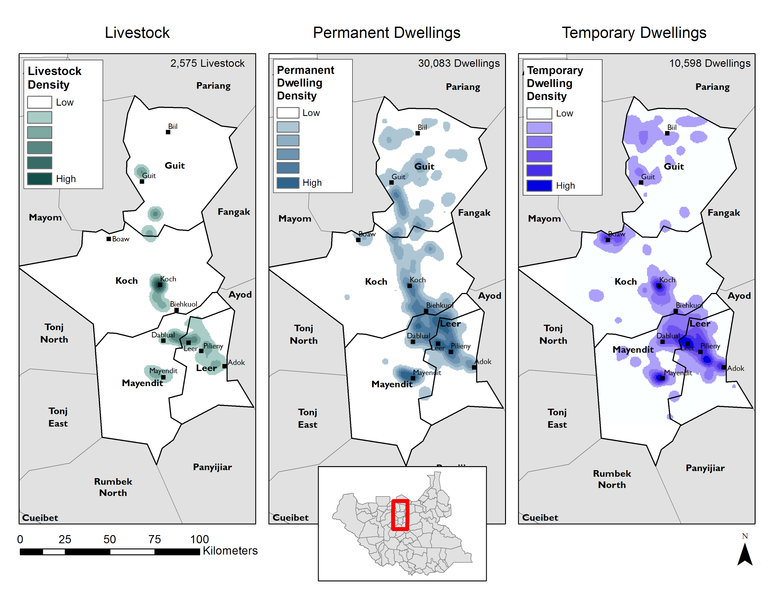
6000+ volunteers worldwide - located people and animals in war-torn South Sudan
Density of livestock, permanent dwellings, and temporary dwellings identified by crowd sourced analysis
Total Map Tiles Analyzed | 295,181
Total Users | 6,262
Total Map views | 3,568,801
Average views per map tile | 12
Total individual tags placed | 750,439
Total unique features identified | 46,036
Permanent dwellings (within study area) | 32,114 (30,083)
Temporary dwellings (within study area) | 11,203 (10,598)
Herds of livestock (within study area) | 2,719 (2,575)
Notes:
In just two weeks, more than 6200 volunteers worked on this campaign and identified more than 46,000 features across 14,000 square kilometers, helping FEWS NET obtain the information they needed to evaluate the reality on the ground. Subsequently, the food insecurity level in Unity State was raised again to a level of emergency. Unfortunately, as new instances of violence have spread across South Sudan, it is difficult to anticipate when this crisis will ease.
· The cost was $50,000, this reflects a 50% discount
· We used this data to triangulate other information we had on displacement. IN turn our analysis of displacement was used in our food security analysis. We also shared this data with WFP for internal programming use.
· Yes, there are a number of other ways in which we are considering how hi resolution satellite imagery might be used. These include monitoring market functioning and livestock body conditions and improved measurement of area planted.

Slide 26
Tools to measure and compare the severity of food insecurity - the IPC
A set of protocols and tools to classify the severity of food insecurity and provide actionable knowledge for decision support.
A process for multiple stakeholders to share information and build technical consensus.
The IPC aims to improve the comparability, rigor, transparency, and relevance of food security analysis.
Notes:
Global IPC initiative led by a group of international partners, including FEWS NET. Coordinated via a Global Support Unit in Rome
Comparability allows decision makers to prioritize needs – compare Niger with Malawi with Guatemala with Afghanistan.
IPC processes held regularly in some countries to develop joint IPC analysis.

Slide 27
IPC 2.0 Acute Food Insecurity Reference Table
Notes:
Acute IPC released in 2012.

Slide 28
IPC phases in South Sudan
State | June Outlook |  | Vulnerability to conflict
 | Highest Jun-Sep phase | Highest Oct-Jan phase
Juba | - |  | Very trade dependent, food aid dependent, Likely front line
Eastern Equatoria | Phase 2 | Phase 2 | Trade dependent
Central Equatoria | Phase 2 | Phase 2 | Potential front line
Western Equatoria | Phase 3 | Phase 2 | -
Upper Nile | Phase 4 | Phase 3 | Very trade dependent, food aid dependent, Likely front line
Unity | Phase 4 | Phase 3 | Very trade dependent, food aid dependent, Likely front line
Jonglei | Phase 3 | Phase 3 | Trade dependent, food aid dependent, Potential front line
Northern BeG | Phase 4 | Phase 3 | Very trade dependent, food aid dependent
Western BeG | Phase 4 | Phase 3 | Trade dependent
Warrap | Phase 3 | Phase 2 | Trade dependent
Lakes | Phase 3 | Phase 2 | Trade dependent
Notes:
double check this table. Phases don’t match with maps.

Slide 29
Key take-aways
Famine early warning has progressed considerably in the last 30 years
After 30 years, we are pretty good at predicting when/where/how bad an “old fashioned” drought-induced famine might occur. Science behind El Nino has progressed hugely, understanding of livelihoods means much more nuanced view of impacts of shocks, can compare thanks to IPC.
Science and technology continue to evolve. Crowdsourcing, high res satellites.
EW systems were not designed for understanding impact of conflict. There is some overlap and EW lessons/tools to be applied but it requires much more specific focus. All of the world’s current near-famines are conflict related (SS, NE Nigeria, Yemen, Somalia)

Slide 30
TOOLS FOR EARLY WARNING AND THEIR ROLE IN CONFLICT MITIGATION- Wrap Up
Key Take-aways:
The world must invest in prevention and risk mitigation
EW tools valuable only to extent they generate early action
Need operational, funding, institutional reform-some movement
Those with greatest capacity to avert crises only weakly accountable to those at risk!
Closer alignment of political and humanitarian risk
Adopt (shared) risk management strategies and create incentives for appropriate risk taking
Develop early action platforms that can scale up and adapt as necessary
Optimize preparedness by maintaining certain level of operational redundancy
Program with maximum flexibility and adaptability in mind combined with closer integration of humanitarian and development work
BOLD programming vs. stifling culture of risk aversion

