Slide 1

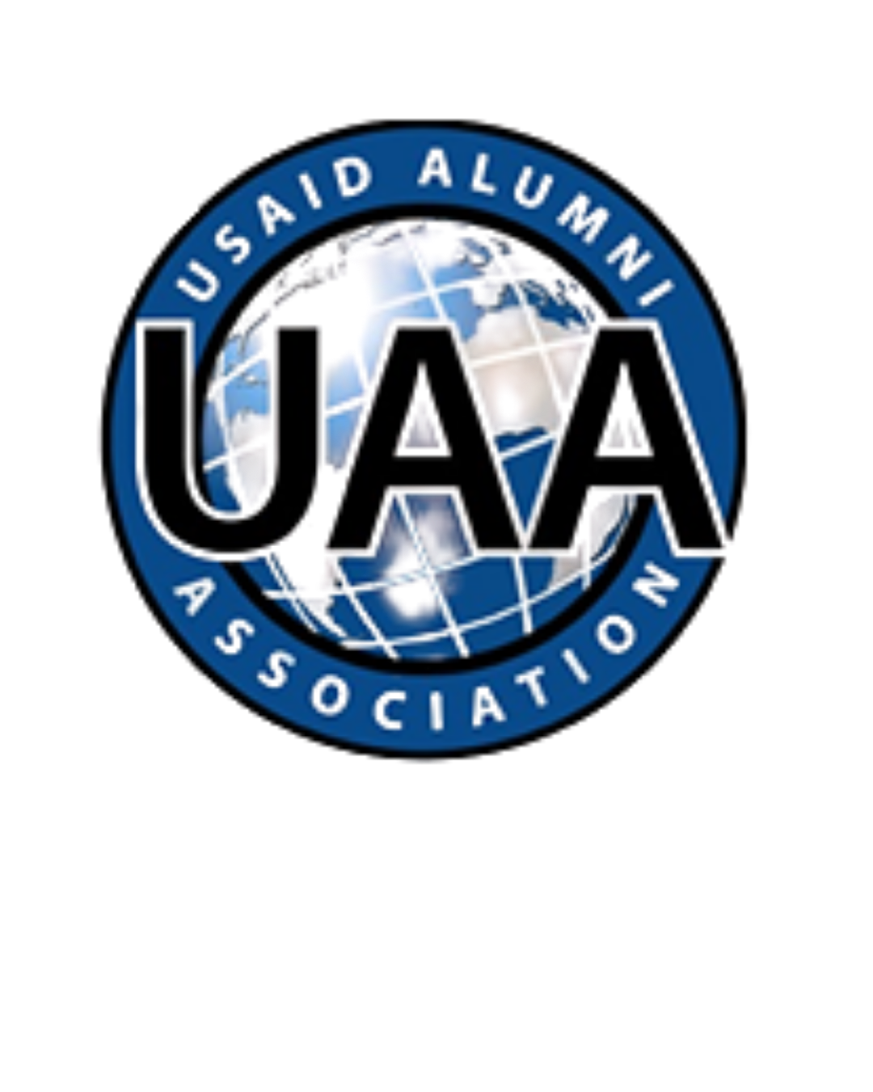
WHY FOREIGN ASSISTANCE MATTERS
Notes:
International assistance makes America stronger at home and abroad, ensuring we remain a global superpower to outcompete rivals like China, prevent threats from reaching our shores, and strengthen our economy.

Slide 2
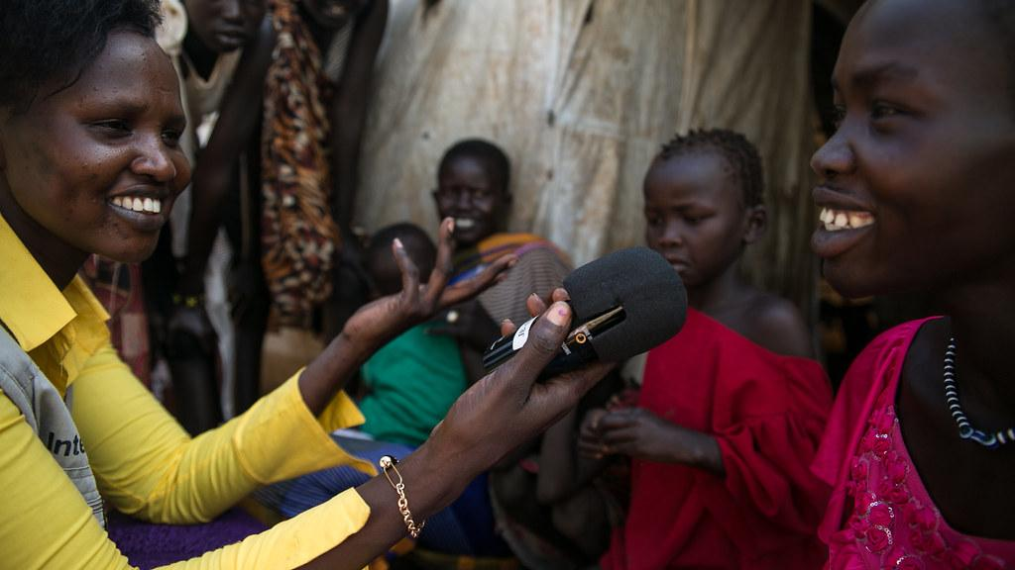
FOREIGN ASSISTANCE: GLOBAL IMPACT
HAS SAVED BILLIONS OF LIVES
HAS LIFTED HUNDREDS OF MILLIONS FROM EXTREME POVERTY
HAS SUPPORTED DEMOCRATIC TRANSITIONS AND HUMAN RIGHTS IN 100+ COUNTRIES
PROTECTS AMERICA
CREATES AMERICAN JOBS
Notes:
International assistance produces results. Through foreign aid, the United States can have an impact on global issues.
Since 1990, U.S. international assistance has helped lift close to a billion people out of extreme poverty.
For example, U.S. assistance has helped alleviate the devastating effects of malaria, a leading cause of childhood death worldwide, averting 2.2 billion cases of malaria and 12.7 million malaria deaths.
America’s HIV/AIDs programs, launched by President Bush, have helped save over 25 million lives.
Additional Examples to chose from:
Key Statistical Impacts (with sources)
25+ million lives saved from HIV/AIDS since 2003 through the President’s Emergency Plan for AIDS Relief (PEPFAR). (Source: U.S. Department of State, PEPFAR Annual Reports)
20+ million people currently receiving life-saving HIV treatment supported by U.S. programs. (Source: PEPFAR 2023–2024 Data)
5.5 million babies born HIV-free to HIV-positive mothers in PEPFAR countries. (Source: PEPFAR Impact Reports)
Global malaria deaths reduced by ~36% since 2000, with the U.S. as the largest donor to malaria control efforts. (Source: World Health Organization, World Malaria Report)
Child mortality cut by over 50% globally since 1990, driven largely by U.S.-funded vaccines, nutrition, and maternal health programs. (Source: UNICEF / WHO / World Bank Joint Estimates)
Over 60 million people gained access to clean drinking water and 40+ million to sanitation through U.S. assistance since 2008. (Source: USAID Water & Development Reports)
23 million people lifted out of poverty and 3+ million children protected from stunting through Feed the Future food security programs. (Source: USAID Feed the Future Results Framework)
100+ million children supported with basic education (school access, teacher training, and learning materials). (Source: USAID Education Strategy Reports)
U.S. humanitarian assistance reaches over 100 million people annually with food, shelter, and emergency medical care. (Source: U.S. Office of Foreign Disaster Assistance / UN OCHA)

Slide 3

FOREIGN ASSISTANCE: PROTECTS AMERICA
DEFENDS AGAINST PANDEMICS & HEALTH THREATS
ADDRESSES ROOT CAUSES OF CONFLICT AND INTERNATIONAL CRIME
REDUCES THE DRIVERS OF ILLEGAL MIGRATION TO THE UNITED STATES
STRENGTHENS AMERICAN GLOBAL LEADERSHIP/BUILDS GLOBAL PARTNERSHIPS
COUNTERS COMPETITORS’ INFLUENCE
Notes:
U.S. assistance created rapid responses to multiple deadly disease outbreaks around the world, including Ebola, Mpox, and the Marburg virus, helping to contain them and minimize their threat to American lives.
In the Northern Triangle–and area in Central America of significant migration to the United States, U.S. international assistance programs helped reduce migration rates by up to 68% in targeted communities. This includes programs to combat gang activity and violence and create jobs to that people can stay home.
Moved Countries from Instability to Strategic U.S. Partners
examples include
South Korea
Taiwan
Indonesia
Vietnam
Colombia
Poland

Slide 4
FOREIGN ASSISTANCE: CREATES AMERICAN JOBS
CREATES MARKETS FOR AMERICAN EXPORTS
2/3 OF U.S. EXPORT GROWTH FROM AID PARTNER NATIONS
13 OF AMERICA’S TOP 15 TOP EXPORT MARKETS WERE AID RECIPIENTS
GENERATES OVER $2 BILLION IN U.S. AGRICULTURAL EXPORTS
STRENGTHENS AMERICAN UNIVERSITIES AND COMPANIES, ADVANCING INNOVATION AND COMPETITIVENESS
PROTECTS U.S. FARMERS LIVELIHOODS
USAID SAVED $3 BILLION WHEAT HARVEST AND PREVENT SWINE FEVER
Notes:
More than 50% of U.S. exports now go to the development world.
95% of the world’s consumers live outside of the United States.
Two Thirds of the growth in U.S. exports occurred in USAID partner countries.
Assistance programs open investment opportunities in emerging markets for America companies.
Rust & Swine Flu examples
Preventing wheat rust from coming to American is one of USAID's greatest contributions to U.S. agriculture. A new and virulent strain of wheat stem rust first appeared in Africa, although the disease that was assumed to have been eliminated 50 years. The new strain could have potentially wiped out American wheat yields. Famine across the Middle East and South Asia was a real possibility.
USAID funded CIMMYT to work with USDA's cereal disease lab in Minnesota to identify the new pathogen. Before the new strain could spread, USAID and CGIAR/CIMMYT worked to replace wheats grown across South Asia (India, Nepal, Pakistan, Bangladesh) with new resistant varieties. The same resistance genes were provided to U.S. researchers similar deployment of resistance was made in the United States. The loss prevented is estimated to be at least $3 billion here in the US alone.
Swine Flu: Additionally, USAID prevented billions of dollars of damage to the American pork industry by helping control the spread of African Swine Fever in pigs in the Gulf of America. USAID’s investments in American research and development in more than 38 U.S. States was pivotal in supporting developing countries’ ability to monitor and respond to threats before they reached U.S. soil.

Slide 5
FOREIGN ASSISTANCE ADVANCES U.S. NATIONAL SECURITY
WHAT HAPPENS ABROAD IMPACTS US AT HOME
A STABLE, PROSPEROUS WORLD IS IN AMERICA’S NATIONAL INTEREST
ONE OF THE 'THREE DS’ OF U.S. POWER: DIPLOMACY, DEFENSE, DEVELOPMENT
USAID WAS A NATIONAL SECURITY AGENCY
Notes:
For every $1 the US spends to prevent conflict, it saves an estimated $16 in response costs.
Critical anti-terror programs combat Al Qaeda and ISIS and minimize risks for U.S. service members

Slide 6
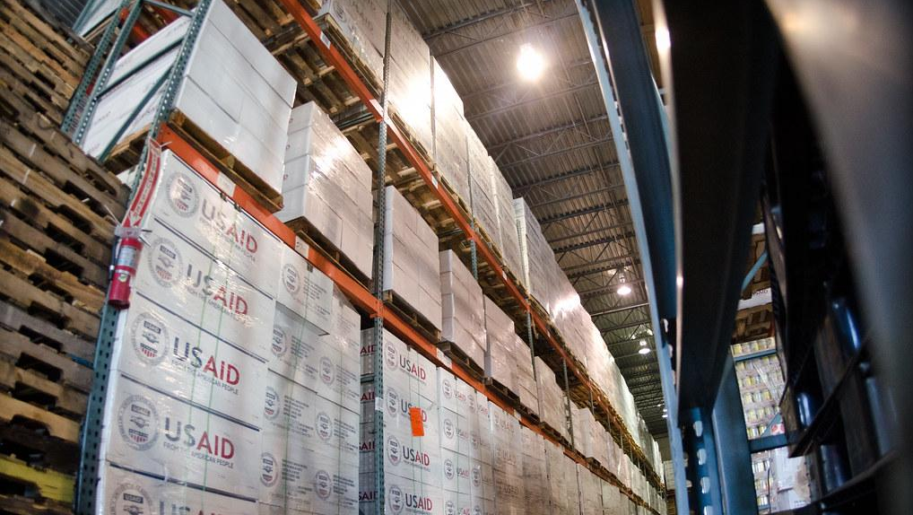
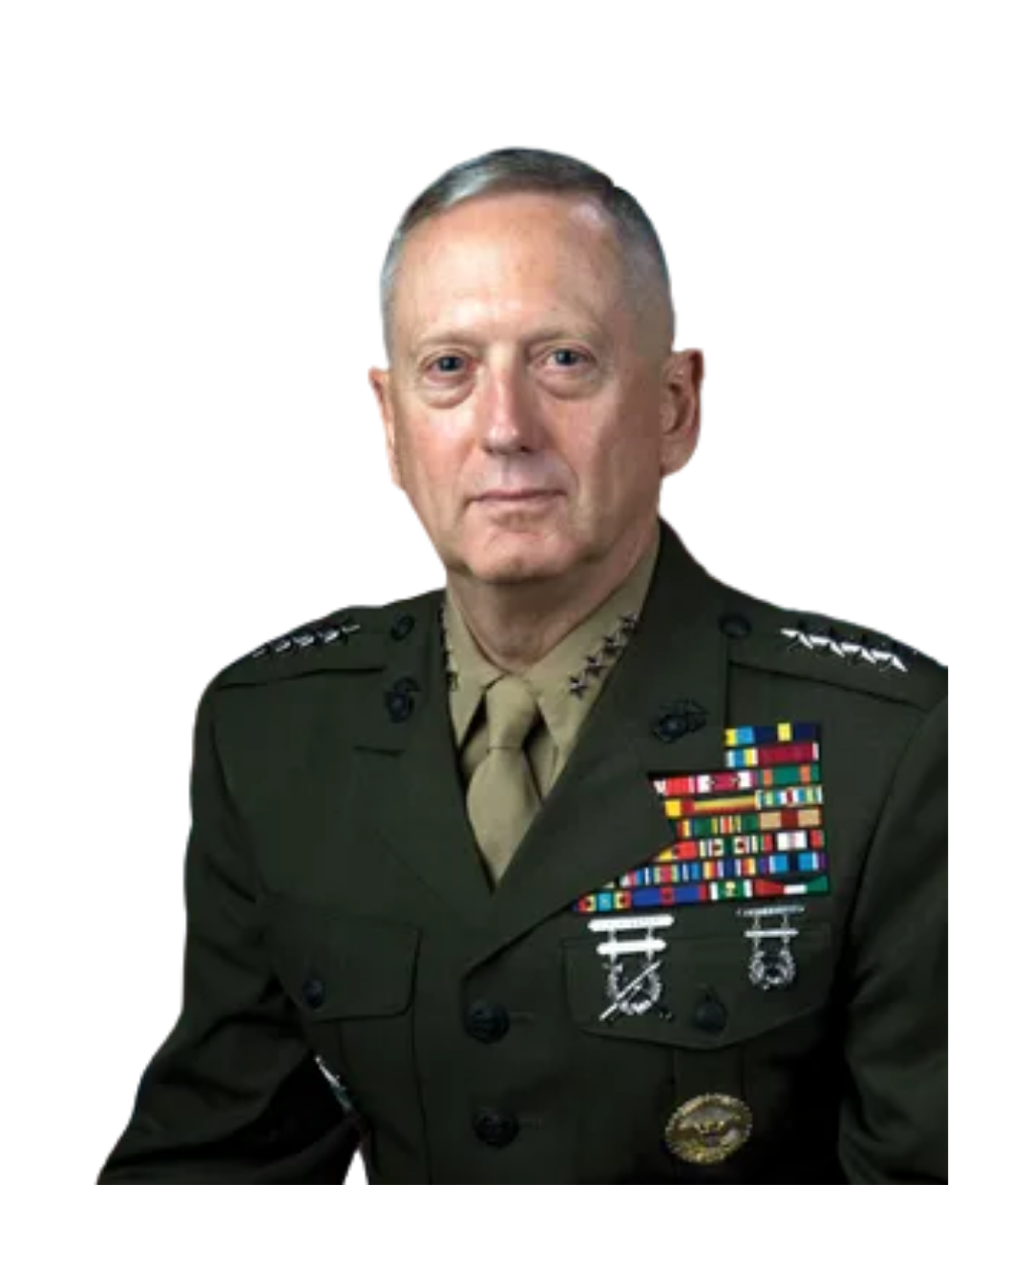
U.S. MILITARY SUPPORTS FOREIGN ASSISTANCE
IF YOU DON’T FUND THE STATE DEPARTMENT FULLY, THEN I NEED TO BUY MORE AMMUNITION.
GENERAL JAMES MATTIS
Notes:
Gen Mattis quote emphasizes that investing in diplomacy and foreign aid prevents future conflicts, and that robust budgets are cost effective national security strategy, saving military spending later. He viewed foreign aid as national security insurance” a vital tool for stability and preventing the need for costly military interventions.
120+ retired Generals and Admirals: USAID prevents conflict.
• Reduces need for military deployments.
• Reduces future military costs and risks to U.S. soldiers.

Slide 7
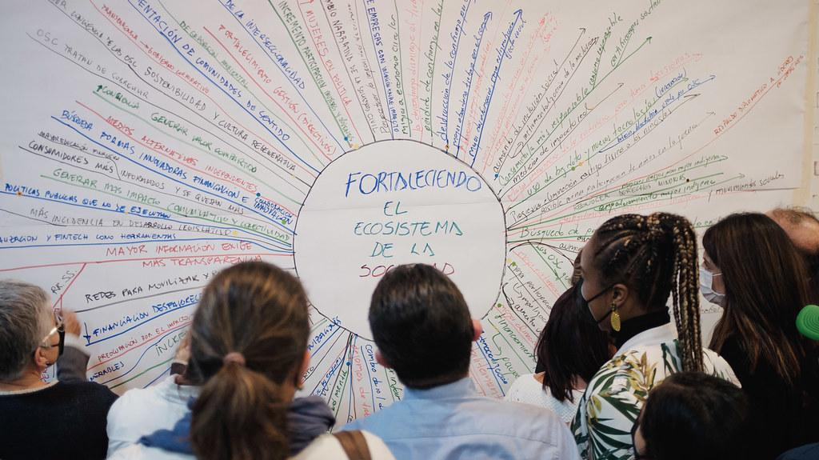
MYTHS
FOREIGN AID IS A LARGE PERCENTAGE OF BUDGET
(FOREIGN ASSISTANCE IS LESS THAN 1% OF THE BUDGET)
USAID GAVE MONEY TO CORRUPT GOVERNMENTS
(USAID WORKS THROUGH INTERNATIONAL AND LOCAL ORGANIZATIONS THAT MEET US AUDIT STANDARDS)
USAID WAS “ROGUE” AND NOT ACCOUNTABLE TO CONGRESS OR THE PRESIDENT
(EVERY PROGRAM IS APPROVED BY THE STATE DEPARTMENT, THE WHITE HOUSE OMB AND NOTIFIED TO CONGRESS)
Notes:
Did you know that the U.S. spends less on international assistance as a proportion of it’s wealth than many of our allies? The U.S. spends .24% of its GNI (gross national income) on international assistance. Countries like Germany, Norway and Sweden contribute significantly more .82%, 1.1% nad .93% respectively. During President Reagan’s time in office, the US. spent .6% of GDP on international assistance.
Every dollar of U.S. assistance is heavily scrutinized to prevent waste, fraud and abuse. Every program is approved by Ambassadors at post and by the State Department leadership, as well as the White House Office of Management and Budget and four Congressional oversight committees. Between October 2018 and September 2023, the Office of the Inspector General conducted nearly 3,000 audits of programs, totalling 216.6 billion dollars–or nearly 95% of all USAID Funding during those years. Of that total, only .3% was flagged for further investigation.
See WASHINGTON POST Article The White House Wildly Inaccurate Claims About USAID on Feb 7, 2025

Slide 8
BUILD YOU OWN LOCAL SLIDE ON FOREIGN ASSISTANCE
EXAMPLE:
USE PERSONAL EXAMPLES THAT REINFORCE KEY MESSAGES
DISCUSS COMMUNITY EFFORTS: UAA IS A MEMBER OF THE U.S. GLOBAL LEADERSHIP COALITION (USGLC), WHICH ADVOCATES FOR INTERNATIONAL ASSISTANCE AND DIPLOMACY, AID ON THE HILL ETC
RESOURCES:
SEE LEADERSHIP VOICES AND STATE FACT SHEETS AT USGLC WEBSITE
SEE AID ON THE HILL RESOURCES
Notes:
Use USGLC state factsheets and find relevant leadership voices.
Provide examples from your career.

Slide 9

WHERE ARE WE TODAY?
USAID CEASED OPERATIONS ON JULY 1ST, 2025
STAFF REDUCED FROM 13,215 TO LESS THAN 100 WITH 700+ HIRED AT STATE TO PROGRAM FOREIGN ASSISTANCE
STATE DEPARTMENT EXPERIENCED AN 18% REDUCTION IN STAFF
85% OF PROGRAMS TERMINATED IN MORE THAN 100 COUNTRIES

Slide 10

TODAY’S GLOBAL CHALLENGES REQUIRE AMERICAN LEADERSHIP
POLYCRISES:
CONFLICT AT HIGHEST LEVELS SINCE WWII LEVELS
RECORD GLOBAL DEBT
STALLED DEVELOPMENT
ENVIRONMENTAL DISASTERS/EMERGENCIES
GLOBAL DEMOCRATIC BACKSLIDING
COLLAPSE OF TRUST IN AMERICAN-LED INTERNATIONAL ORDER

Slide 11
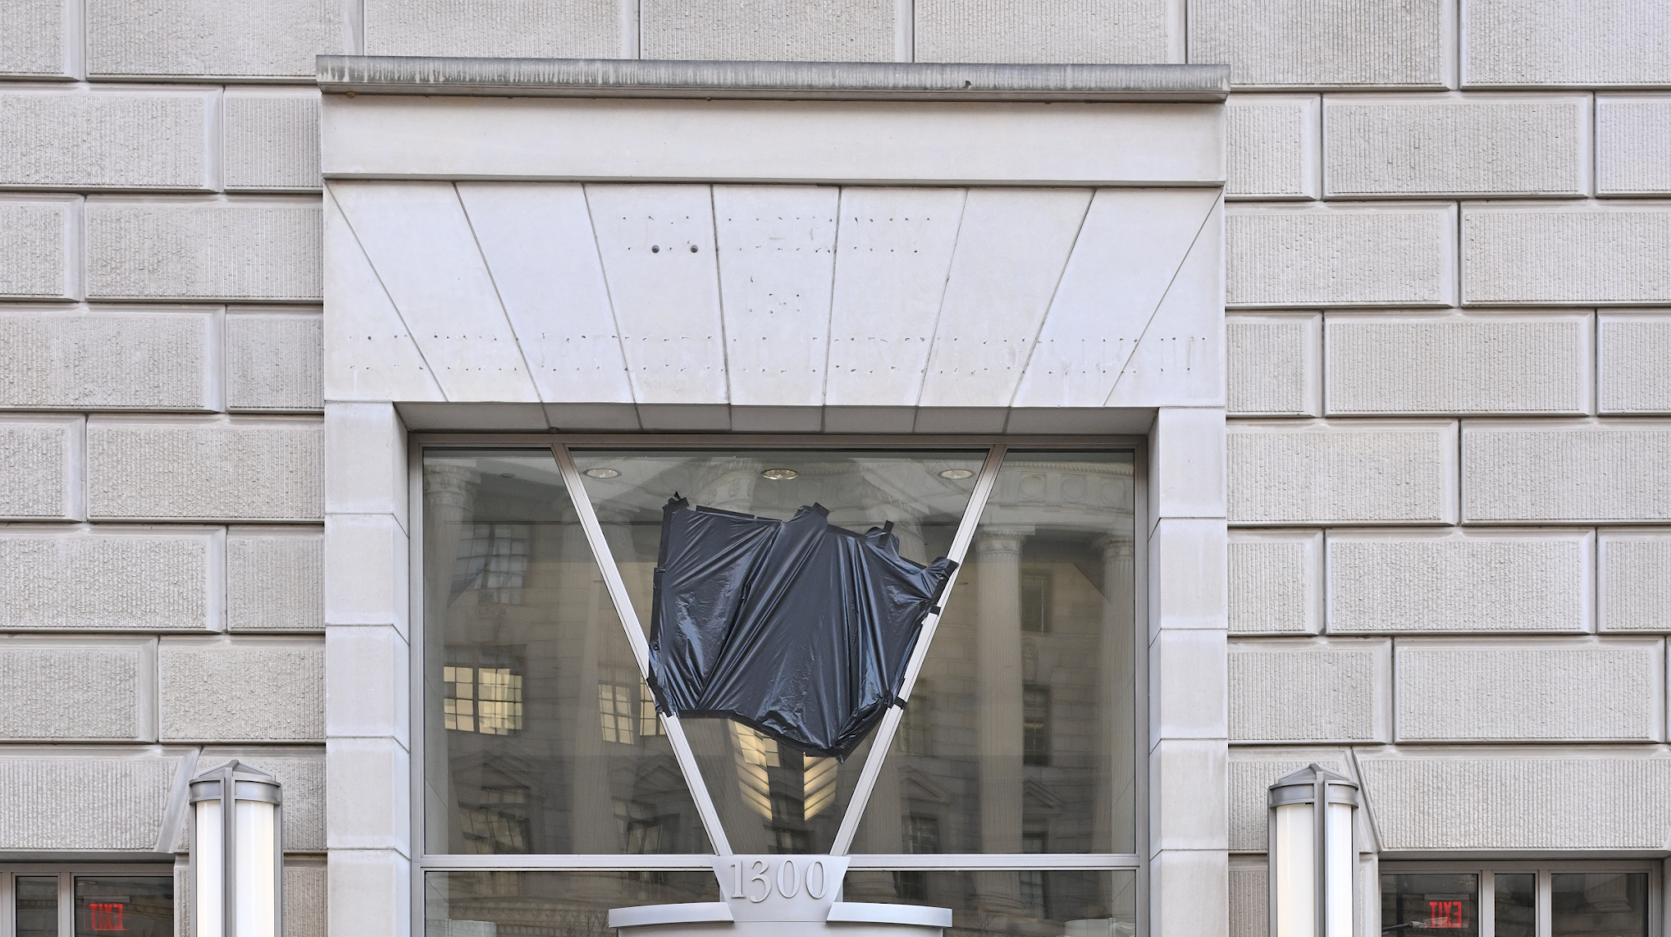
DISMANTLING USAID: CONSEQUENCES
WEAKENS AMERICAN POWER
ELIMINATES DEVELOPMENT AS A DISTINCT INSTRUMENT OF NATIONAL POWER
DIMINISHES INSTITUTIONAL CAPACITY, FIELD PRESENCE, AND TECHNICAL EXPERTISE TO ADVANCE NATIONAL SECURITY AND PROSPERITY
ERODES U.S. LEADERSHIP ROLE—CREATING VACUUMS BEING FILLED BY STRATEGIC COMPETITORS SUCH AS CHINA

Slide 12
AMERICAN LEADERSHIP MATTERS
FOREIGN ASSISTANCE SHOULD REMAIN AN INTEGRATED AND INDEPENDENT COMPONENT OF U.S. NATIONAL POWER

